Slide 1

Bypassing conntrack: Optimizing K8s Service By Enhancing IPVS with eBPF
Jianmingfan (kenieevan@github)
Zhiguohong (honkiko@github)

Slide 2
Agenda
目录
01
Problems with K8s Service
02
How to optimize
03
Comparison with industry
04
Performance measurement
05
Lessons from eBPF
06
Future work

Slide 3
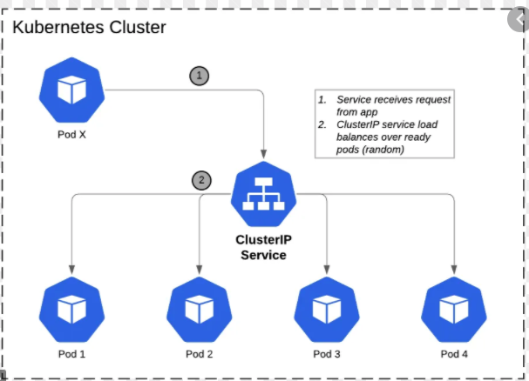
What is K8s Service
It exposes a set of pods via VIP using a load balancer
Two types
ClusterIP provides in-cluster access
NodePort provides out-of-cluster access
Major modes
Iptables
IPVS

Slide 4
Iptables mode
How it works
DNAT at PREROUTING chain
SNAT at POSTROUTING chain
Pros
Iptables is widely adopted in popular Linux distributions
Cons
O(N^2) in control plane / O(N) in data plane
Poor in scheduling algorithm
Iptables rules are difficult to debug

Slide 5
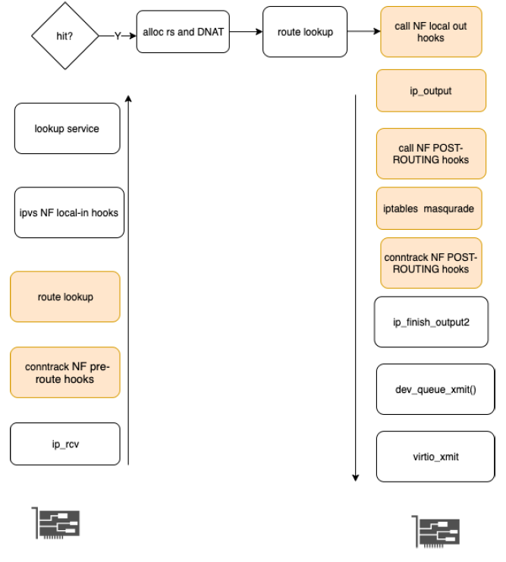
IPVS mode
Services are organized in hash table
IPVS DNAT
conntrack/iptables SNAT
Pros
O(1) time complexity in control/data plane
Stably runs for two decades
Support rich scheduling algorithm
Cons
Performance cost caused by conntrack
Some bugs

Slide 6
How to optimize
Guidelines
Use less CPU instructions to process each packet
Don’t monopolize CPU
Stability and more functionalities
Notes:
用尽量少的cpu指令处理每一个报文
不能独占cpu
兼顾产品的稳定性，功能足够丰富

Slide 7
Alternative solutions?
Why not use DPDK?
DPDK performs busy polling even when network is idle.
Why not use a pure eBPF service?
Not mature enough
Notes:
为什么DPDK不行？
独占cpu，不适合分布式的lb
为什么纯粹的eBPF方法不行
不够成熟

Slide 8
eBPF brief
Write C
Compile into eBPF assembly code
Inject to kernel
Attach to network tc hooks
Triggered by ingress/egress packets
Notes:
编写eBPF程序
编译成eBPF中间代码
注入内核
挂载到network traffic control
报文激发eBPF代码

Slide 9
IPVS bypass conntrack
Why IPVS depends on conntrack?
Iptables/conntrack SNAT
How IPVS bypasses conntrack?
Ingress
Move IPVS Netfilter hook from local-in to PREROUTING
The challenges
Skb’s pointer to route is NULL during PREROUTING
No de-fragment is done during PREROUTING
Notes:
编写eBPF程序
编译成eBPF中间代码
注入内核
挂载到network traffic control
报文激发eBPF代码

Slide 10
IPVS bypass conntrack (con.)
Egress
Original way
Nf local-out -> ip_output→ nf post-route -> ip_finish_output
The new way
Call ip_finish_output directly
Pre-route
Conntrack
Pre-route
route
IPVS entry
Post-route
Iptables
snat
Conntrack
Post-route
IPVS mode data path
Pre-route
IPVS entry
BPF SNAT
IPVS-eBPF mode data path
Notes:
本来的逻辑：
Nf local out -> ip_output -> NF postrouting -> ip_finish_output
修改成：
对kenel 做了hack，直接访问ip_finish_output

Slide 11
How eBPF does SNAT
Why does SNAT with eBPF
eBPF program is easy to deploy
How to do SNAT in eBPF
Do SNAT in TC egress
Do reverse SNAT in TC ingress
Tc egress
Hit eBPF map?
nic
N
Y
Does SNAT
nic
Notes:
在linux traffic control上挂一段eBPF 代码，在网卡出报文之前做SNAT
尽量将大部分代码放在eBPF中，方便升级和维护。
eBPF loader 创建eBPF map时，将map的id 传给IPVS内核模块
在ip_vs_new_conn 时，插入eBPF map
(protocol, clientip:cport -> targetip:dport)
在ip_vs_conn_unlink时，删除eBPF map
由于eBPF中没有timer机制

Slide 12
How eBPF does SNAT
How IPVS talks with eBPF program?
eBPF map id is passed to IPVS module
Ip_vs_new_conn() inserts eBPF map
Key: (protocol, cip:cport , rsip:rsport)
Value: (protocol, lip:lport, rsip:rsport)
Ip_vs_conn_unlink() deletes entries in eBPF map
add
IPVS
eBPF map
refer
eBPF SNAT
del

Slide 13
Comparison with industry
V.S service in pure eBPF
Reuse the IPVS’s functionality and maturity
Many scheduling algorithms
Reuse IPVS timer to reclaim eBPF map
More efficient and secure
V.S Taobao IPVS SNAT patch
Bypass conntrack/iptables
Less modification to kernel
Notes:
在linux traffic control上挂一段eBPF 代码，在网卡出报文之前做SNAT
尽量将大部分代码放在eBPF中，方便升级和维护。
eBPF loader 创建eBPF map时，将map的id 传给IPVS内核模块
在ip_vs_new_conn 时，插入eBPF map
(protocol, clientip:cport -> targetip:dport)
在ip_vs_conn_unlink时，删除eBPF map
由于eBPF中没有timer机制

Slide 14
Performance measurement
Pitfalls
Performance of clusters of the same configure may differ
Performance of a cluster in different time slot may differ
Due to CPU oversold
Suggestion:
Run the test against the same cluster during near time
Make CPU the bottleneck
1 CPU handles 500,000 pps
Make LB the bottleneck
The target server and client server shall be powerful enough
Notes:
配置一样的cluster，性能可能不同。
多个CVM分布在同一台物理主机
同一个cluster，在不同的时间段，性能可能不同
cpu 超卖
使用同一个cluster，在相近的时间段，比较两种mode
使得cpu成为瓶颈点
cpu和网卡pps的比例关系 < 1/50w pps
Target server pool /client pool 的配置要足够强大。

Slide 15
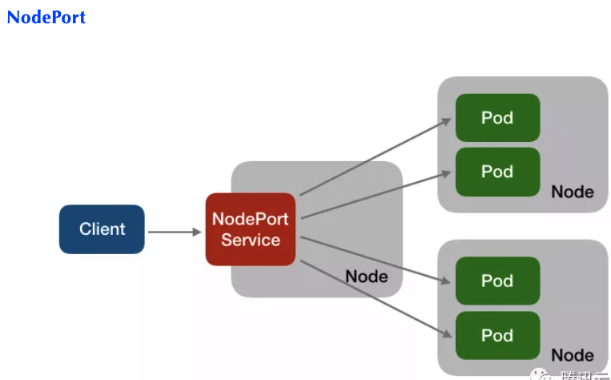
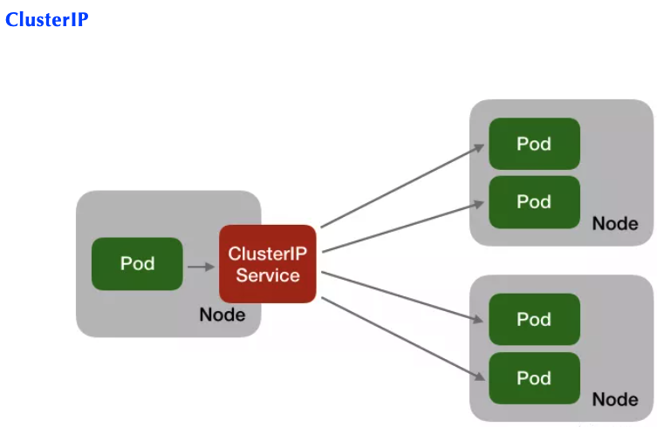
Test topology

Slide 16
Test result
Service type | Short connection cps | Short connection P99 latency | Long connection pps
ClusterIP | +40% | -31% | not available
NodePort | +64% | -47% | +22%

Slide 17
Test result
Perf shows number of instructions per request drops by 38%

Slide 18
Lessons from eBPF
No loop support in eBPF verifier (Linux 4.14)
#param unroll
Size limitation of BPF program <= 4096
Move SNAT allocate port loop into IPVS kernel module
Bounded loop support in Linux 5.3
Size limitation of BPF program is one million after Linux 5.2
Notes:
https://lwn.net/Articles/794934/

Slide 19
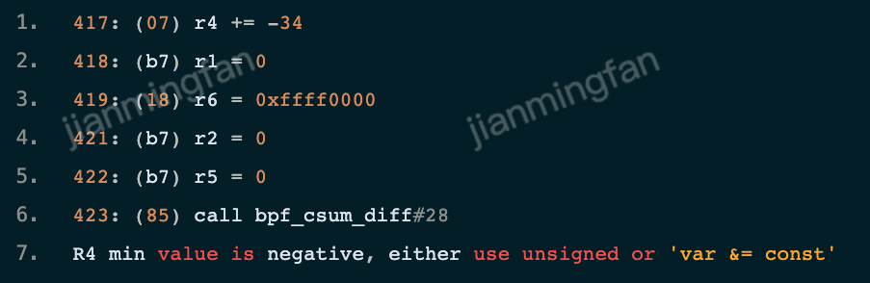
Lessons from eBPF
Too strict check in eBPF verifier
Example:
s64 bpf_csum_diff(__be32 * from, u32 from_size, __be32 * to, u32 to_size);
pass skb->len to bpf_csum_diff()
the verifier reports error
Notes:
https://lwn.net/Articles/794934/

Slide 20
Future work
Open source
The modification to IPVS is already open source
https://github.com/Tencent/TencentOS-kernel/
More components will be open source later
Support more Linux distributions
Build IPVS kernel modules in Ubuntu, Centos
IPVS-eBPF next generation on the way
Implement IPVS SNAT with eBPF without modification to kernel.
Notes:
适配更多的linux 发行版本
Tencent linux , ubuntu, centos
独立开源
内核修改在github.com/Tencent/TencentOS-kernel/

Slide 21

Learn more about TKE
https://cloud.tencent.com/product/tke
Jobs
https://careers.tencent.com/home.html
Thanks!

Slide 23
Bugs solved – 1/2
IPVS conn_reuse_mode=1 low cps
Ip_vs_conn
New ip_vs_conn
nf_conn
Notes:
IPVS conn_reuse_mode=1 low cps
Reason
When cport reuse ocurrs, ipvs will reschedule and create a new ip_vs_conn
The old/new ip_vs_conn share conntrack entry, but with no refcount
When old ip_vs_conn frees, the conntrack is freed.
The new ip_vs_conn loses conntrack. Packet drops.
Solution
Add ref count to fix

Slide 24
Bugs solved – 2/2
DNS resolution delays for 5s
Udp for A
Srcport=x
Udp for A
Srcport=x
Udp for A
Srcport=x
Iptables SNAT
Conntrack insert
Udp for AAAA srcport = x
Udp for AAAA
Srcport=x
DROP
Solution
In eBPF code, add a loop to wrap port alloc and insert.
If insert fails, it will retry alloc.
Notes:
DNS 解析偶尔5s延迟
原因
DNS 同时发了2个UDP请求，分别请求A和AAAA。源端口是cport。
Iptables SNAT 为请求1分配了lport=cport
很快Iptables SNAT 为请求2分配了同样的lport
Conntrack Post routing 函数中，将请求1的lport插入conntrack，成功！
Conntrack Post routing 函数中，将请求2的lport插入conntrack，失败，丢包，导致延迟。
解决方法
eBPF代码在分配lport和插入hash的外围，加了一个大循环，插入失败会重新分配lport。

